Slide 1
5.10 Set Representation
0
4
2
6
7
8
1
9
3
5
S1 = { 0, 6, 7, 8 }
S2 = { 1, 4, 9 }
S3 = { 2, 3, 5 }
Figure 5.36 : Possible tree representation of sets
Disjoint set union : Si U Sj
(2) Find (i)

Slide 2
0
4
6
7
8
4
0
1
9
1
9
6
7
8
S1 U S2
or
S1 U S2
Figure 5.37 : Possible representations of S1 U S2

Slide 3
i | [0] | [1] | [2] | [3] | [4] | [5] | [6] | [7] | [8] | [9]
parent | -1 | 4 | -1 | 2 | -1 | 2 | 0 | 0 | 0 | 4
Figure 5.39 : Array representation of S1, S2, and S3 of Figure 5.36

Slide 4
Class Sets {
public:
// Set operations follow
.
private:
int *parent;
int n; // number of set elements
};
Sets:: Sets(int sz=HeapSize)
{
n=sz;
parent = new int[sz];
for(int i=0; i<n; i++) parent[i] = -1;
}
Program 5.25 : Class definition and constructor for Sets

Slide 5
Void Sets:: SimpleUnion(int i, int j) //Replace the disjoint sets with roots i and j, i! = j with //their union { parent[ i ] = j; } int Set :: SimpleFind( int i) //find the root of the tree containing element i. { while( parent[ i ] >= 0 ) i = parent[ i ]; return i; } Program5.26 : simple algorithms for union and find

Slide 6
Analysis of SimpleUnion & SimpleFind
union(0, 1), union(1,2), union(2,3),
union(3,4), …,union(n-2, n-1)
find(0), find(1),…,find(n-1)
n-1
n-2
• • •
0
Figure5.40: Degenerate tree

Slide 7
Heuristic 1: Weighting rule for union(i,j)
void Sets::weightedUnion( int i, int j) //Union sets with roots i and j, i ≠ j, using the weighting rule. //parent[ i ] = - count[ i ] and parent[ j ] = - count[ j ]. { int temp = parent[ i ] + parent[ j ]; if( parent[ i ] > parent[ j ] ){ // i has fewer nodes parent[ i ] = j; parent[ j ] = temp; } else{ // j has fewer nodes (or i and j have the same number of nodes) parent[ j ] = i; parent[ i ] = temp; }} Program 5.27: Union algorithm with weighting rule

Slide 8
0
1
• • •
n-1
0
2
• • •
n-1
0
3
• • •
n-1
1
1
2
initial
union( 0, 1 )
union( 0, 2 )
0
4
• • •
n-1
• • •
0
1
2
3
1
2
3
• • •
n-1
union( 0, 3 )
union( 0, n-1 )
Figure 5.41 : Trees obtained using the weighting rule

Slide 9
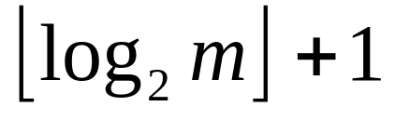
Lemma 5.5
Height(T) ≤

Slide 10
Heuristic 2 : Collapsing rule
int Sets :: CollapsingFind( int i) // find the root of the tree containing element i. // Use the collapsing rule to collapse all nodes from i to the root { for (int r = i; parent[ r ] >= 0; r = parent[ r ]); //find root while( i ! = r){ int s = parent[ i ]; parent[ i ] = r; i = s; } return r; } Program 5.28 : Find algorithm with collapsing rule

Slide 11
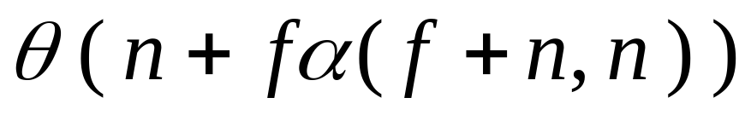
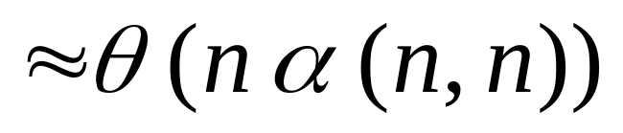
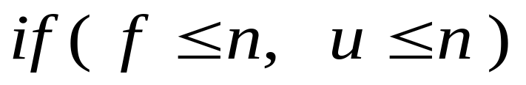
Analysis
Application : Equivalence Classes

